Slide 1

U.S Insurance policy
Guangjin Luo
Notes:
NOTE:
To change the image on this slide, select the picture and delete it. Then click the Pictures icon in the placeholder to insert your own image.

Slide 2
Title and Content Layout with List
Abstract
Introduction
Materials and Methods*
Results
Discussion
Literature Cited

Slide 3
Abstraction
In this project, we used the linear regression model and the stepwise selection in order to create a simple model of how the major insurance company react to certain group of the consumer that react to there personal behavior.
In order to find the best model that can be represent average insurance cost, we would take the measure of U.S. Census Bureau with the following data set, which contains 1338 sample points.

Slide 4
Variable name
age: An integer which represent the age of the consumer
sex: the sex of the consumer,(male or female)
BMI: This is a numerical value of your weight in relation to your height.
children: this is an integer which is the number of children the consumer have
smoker: Yes means the consumer is a smoker and no means the consumer is not a smoker.
region: According to where the consumer live in America, divide the country in to 4 parts geometrically: northeast, southeast, southwest and northwest.

Slide 5
Introduction
During this crises of covid-19, having a good insurance became essential to the daily workers. And yet, only 60% of the Americans are covered by the insurance, and those who are covered, must spend thousands of dollar each month, so I decided to do a research on the estimation on how much money people must spend each year. And gives us a more general idea of how it can be effected American way of living

Slide 6
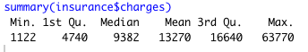
Analysis
First, we would look at the distribution of the charges

Slide 7
We can conclude that in our data points, most people have the insurance bill around 0 to 15000 dollars per year, and the average is 13270 dollars. which is approximate to one third of the average wages in America in 2019.
And we can also see that the distribution is skew to the right with the median of 9382 dollars.

Slide 8
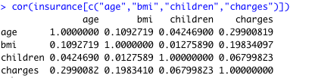
Then we want to see the correlation between each variables, and we get the matrix
We can see that there is a significant relationship between age and charges, bmi and charge children and charges.
And the correlation between age and BMI is also strong.

Slide 9
scatterplot matrix
scatterplot matrix is also showing that as ages go up, the charges also go up, in the graph age vs charge, there is some linear line that shows the relation.

Slide 10
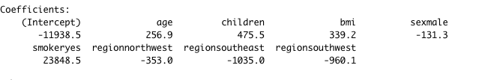
Simple regression model
Code:
model1 <- lm(charges~age+children+bmi+sex+smoker+region,data=insurance)
Result:
The simple model follows the common senses of the health care insurance;
Elder, smoker and bad BMI scores usually links to other sickness.

Slide 11
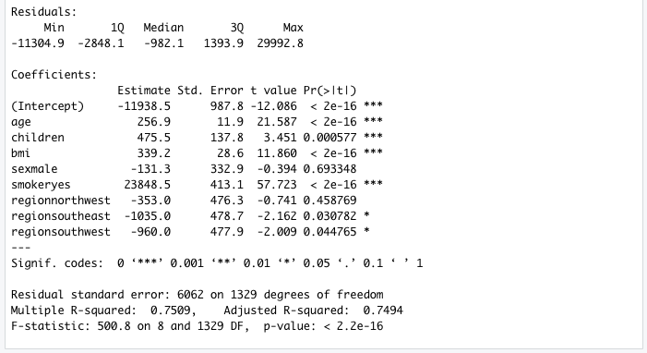
Checking the simple model
summary(model1)

Slide 12
We can see that the R^2=0.75 which is better than expected, considering these data is what the insurance used to decided the charges amount.
And we are simply re-creating it, it is normal. Then we are trying to use step wise elimination to get a better fit model

Slide 13
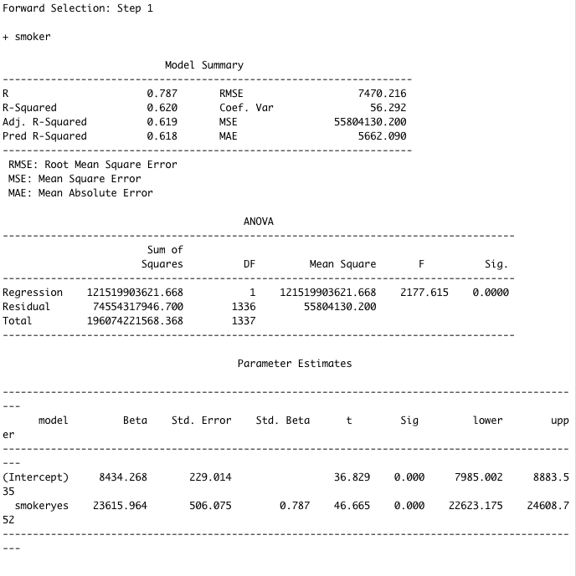
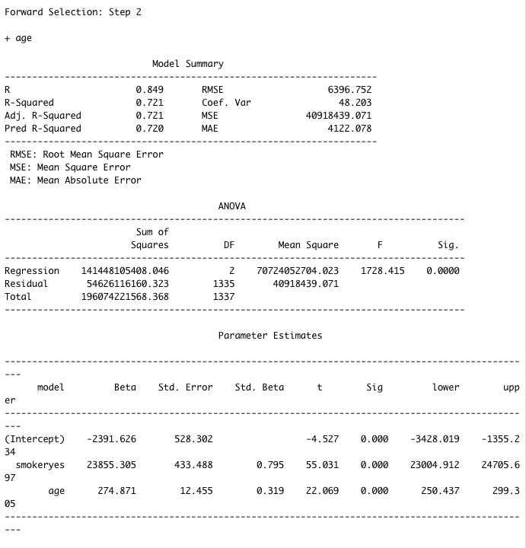

Slide 14
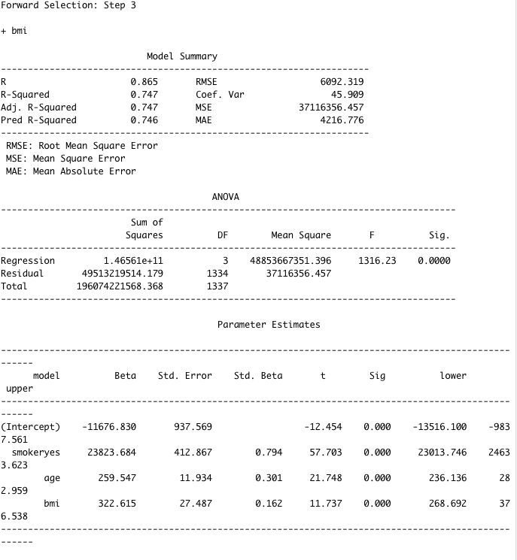
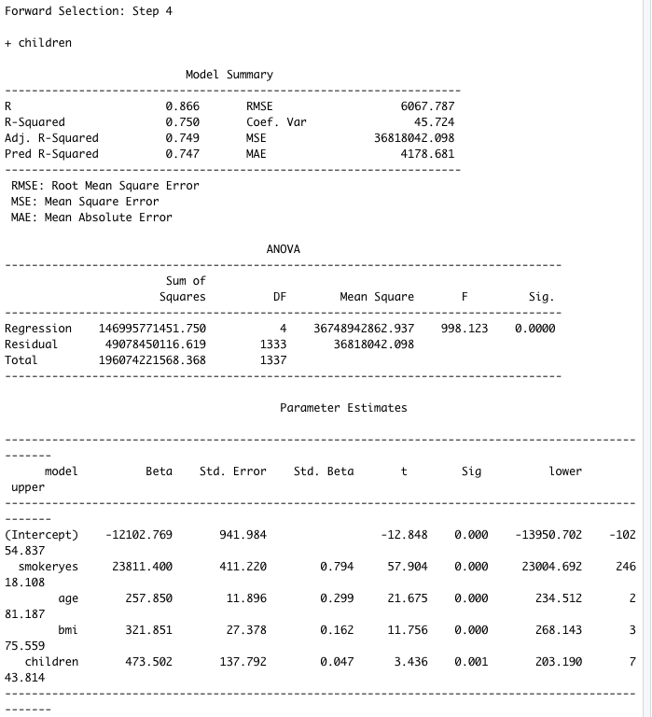

Slide 15
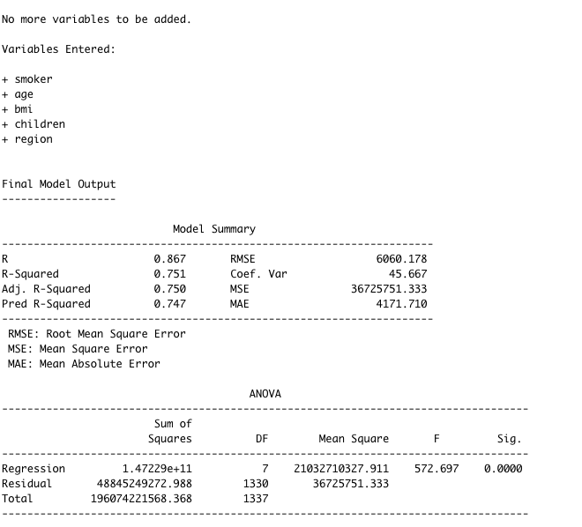
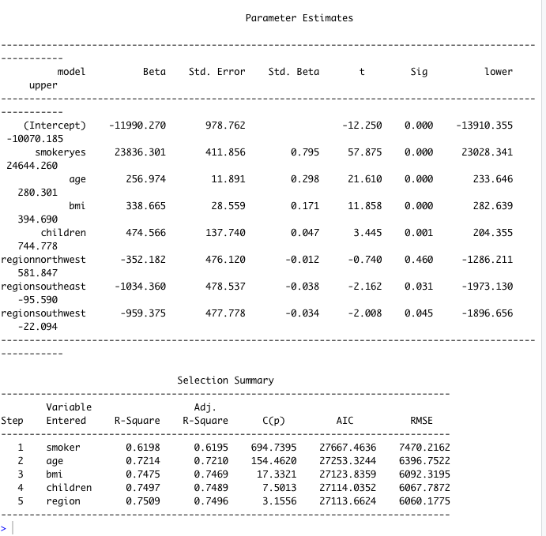

Slide 16
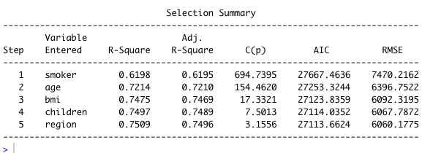

Slide 17
Discussion
As we can see here, the model we create can be useful predicting the insurance charges of the major U.S insurance company. And shown that, most of the group who is charges extra money is the group who are struggling, like the elder, lower BMI group and the people who have multiple children. Which makes them even harder to live or in some cases, they can’t afford the insurance.
However, blaming the insurance company who are charging extra for those group is also unfair, which the risk that are taking insurance them is more than the ordinary health people. And yet, as a beneficial company, making money is sessional to keep the company alive.
So, to be conclude, a better insurance plan, or the government should step in in order to help the company or start its own insurance plan is essential for American people.

Slide 18
Literature Cited
https://blog.csdn.net/tmb8z9vdm66wh68vx1/article/details/79544739?ops_request_misc=&request_id=&biz_id=102&utm_source=distribute.pc_search_result.none-task-blog-2~all~sobaiduweb~default-5
https://github.com/stedy/Machine-Learning-with-R-datasets/find/master

